Slide 1
Generating annotated data
Splitting data
Training
Validation
Test
Standard
Slicing
Results
Results

Slide 2
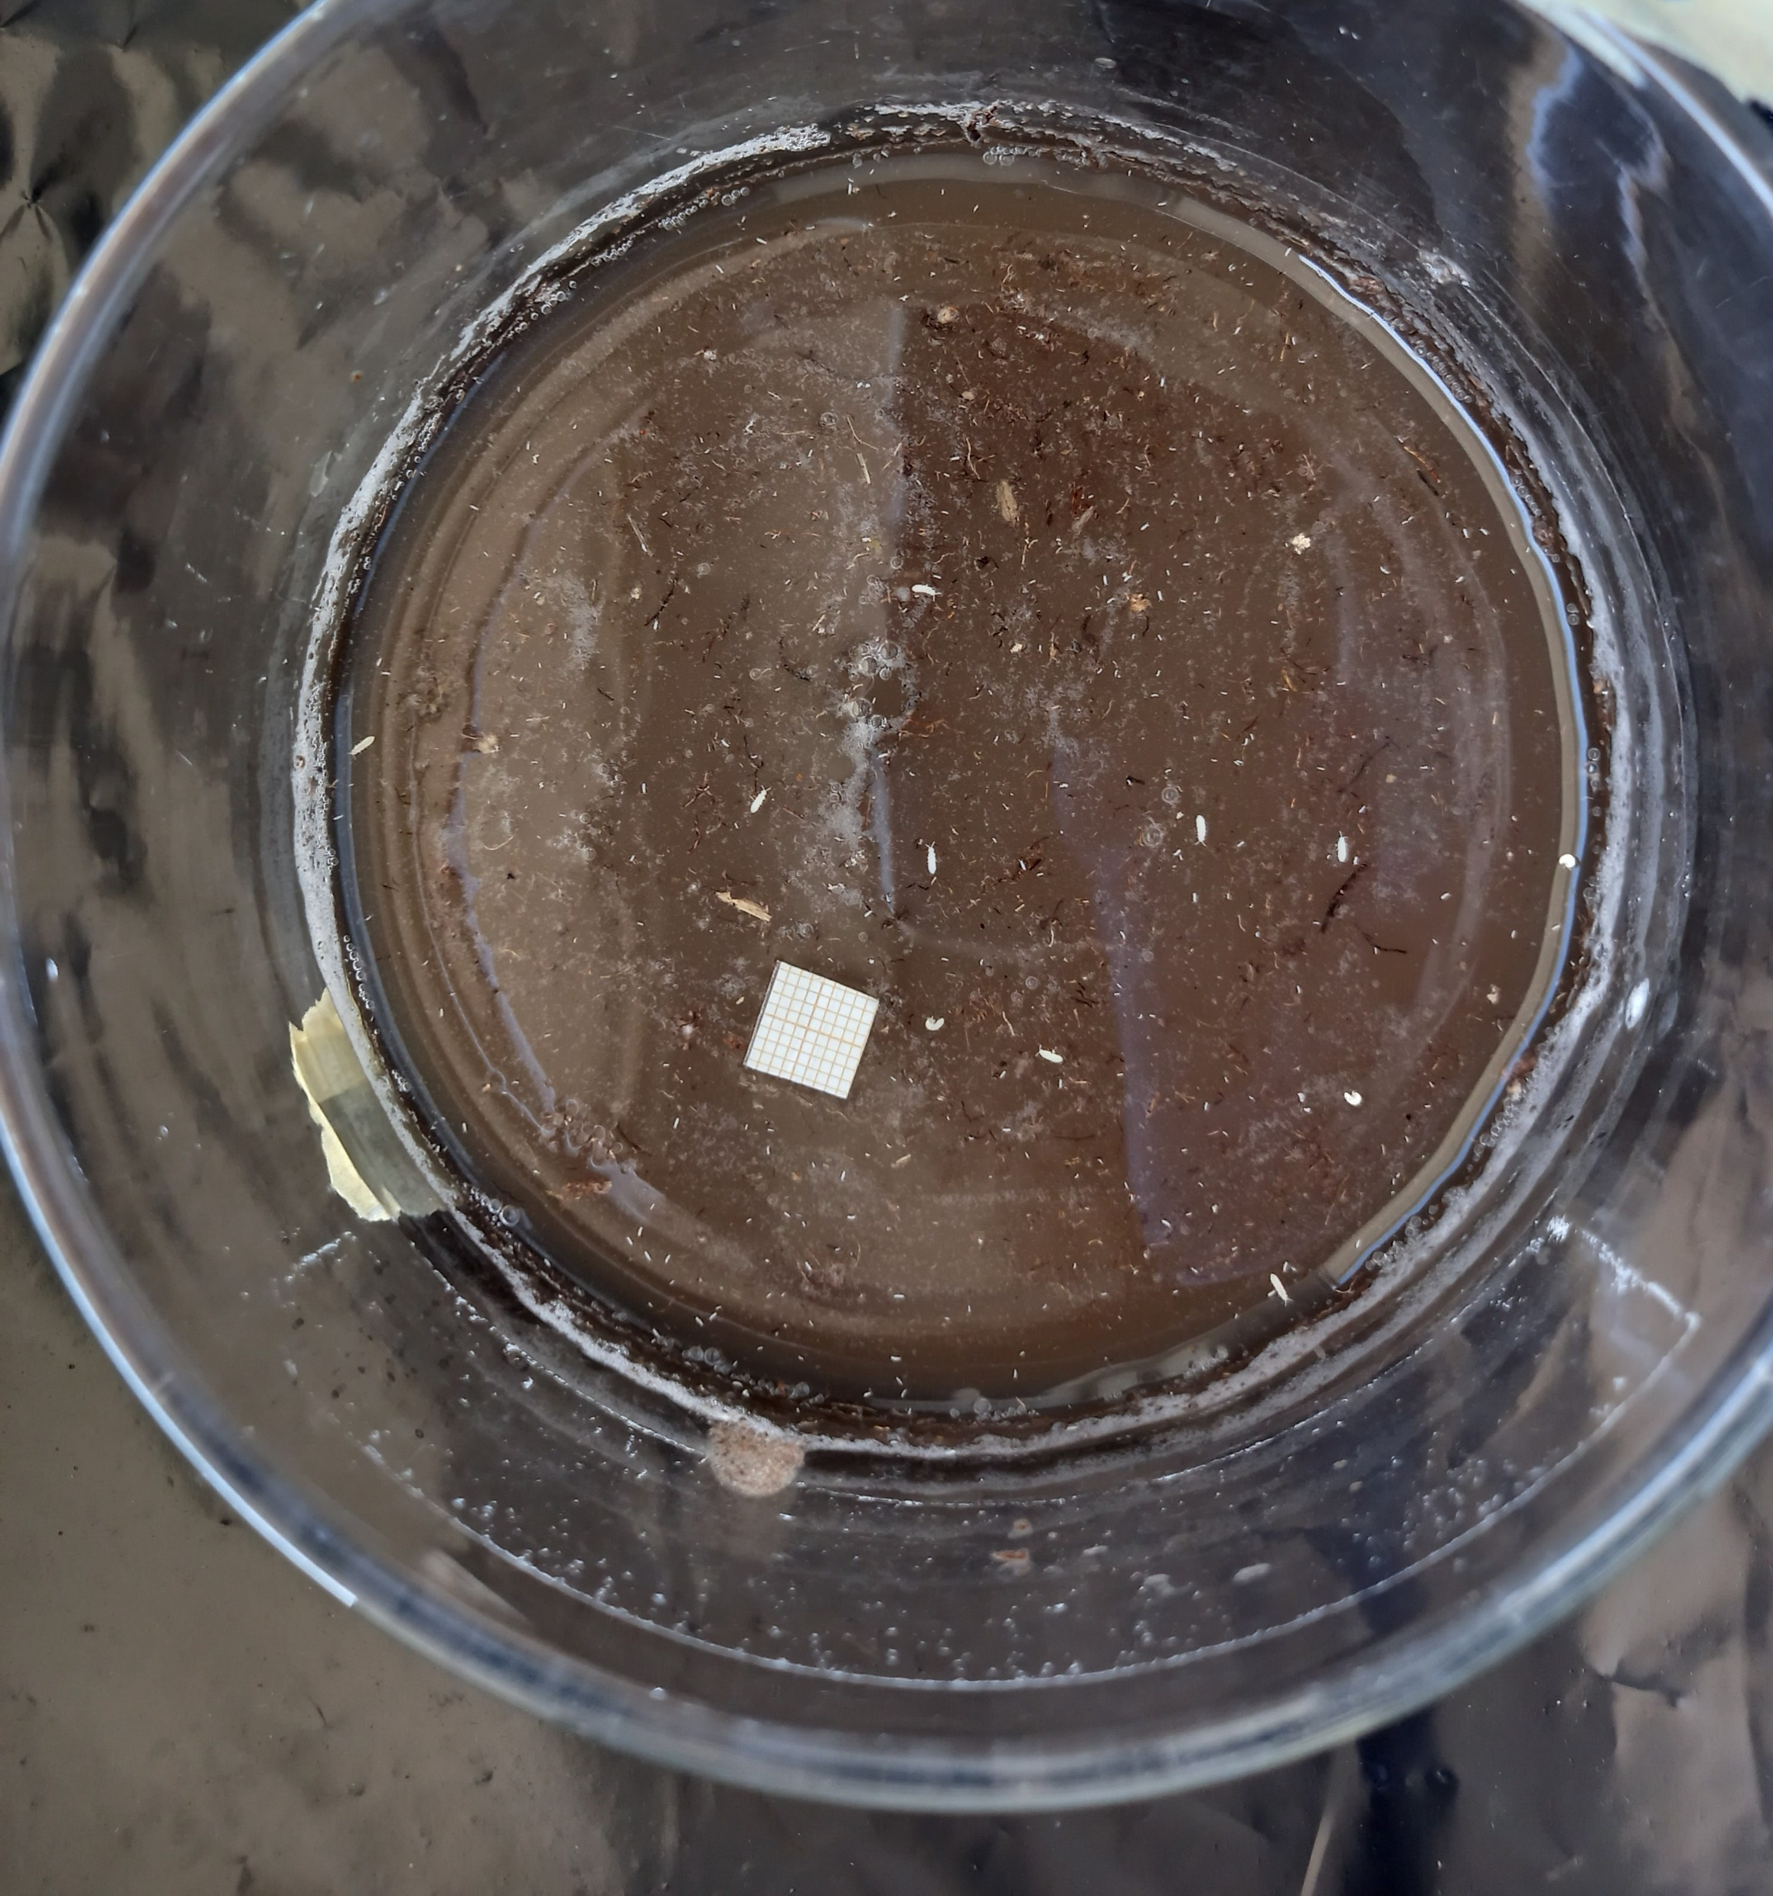

Slide 3
Generating annotated data
127 images with associated mask files
Images from four experiments (A, B, C, D)
Very large variation in dimensions/resolution

Slide 4
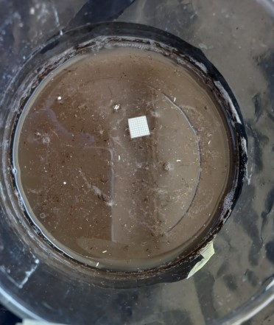
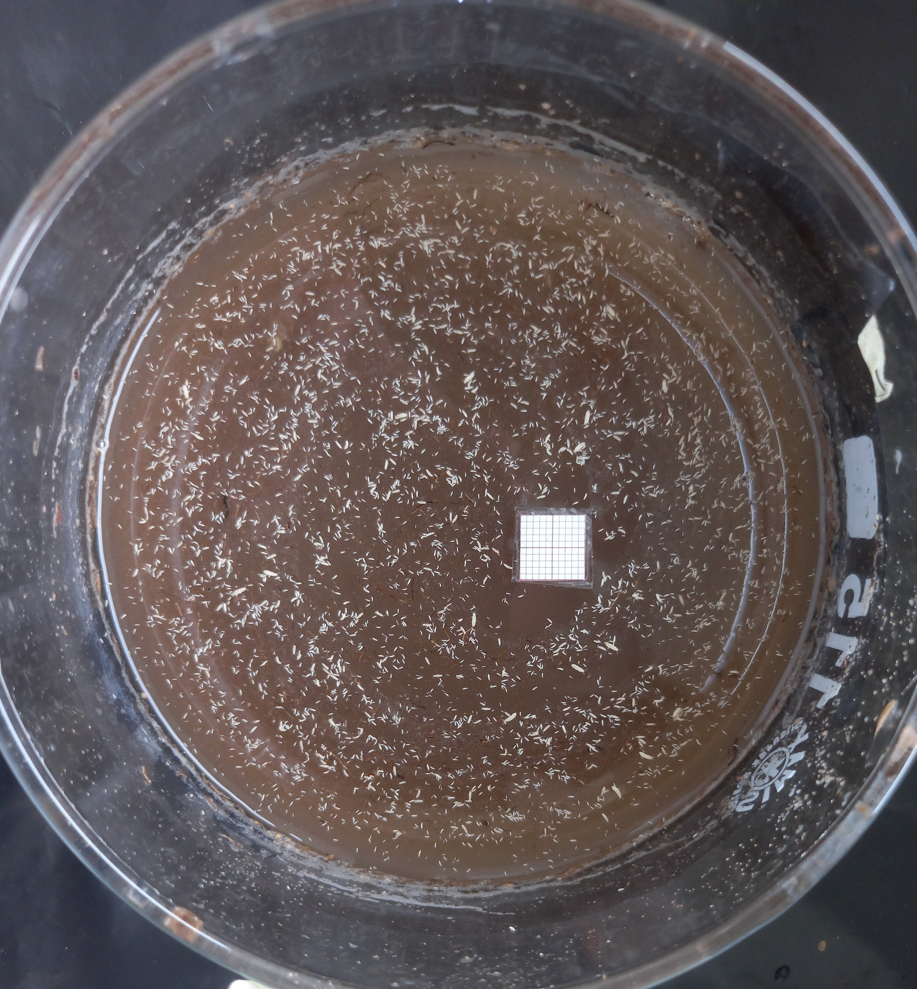
Generating annotated data
127 images with associated mask files
Images from four experiments (A, B, C, D)
Very large variation in dimensions/resolution

Slide 5
Generating annotated data
127 images with associated mask files
Images from four experiments (A, B, C, D)
Very large variation in dimensions/resolution

Slide 6
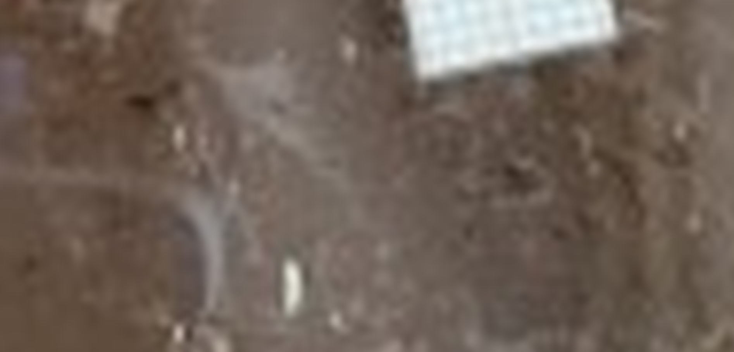
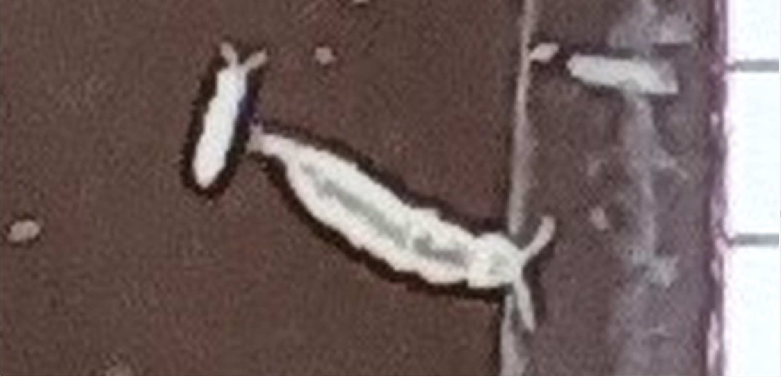
Generating annotated data
127 images with associated mask files
Images from four experiments (A, B, C, D)
Very large variation in dimensions/resolution
2000x zoom
1000x zoom
372 x 441 (71 KB)
6000 x 6467 (9,637 KB)

Slide 7
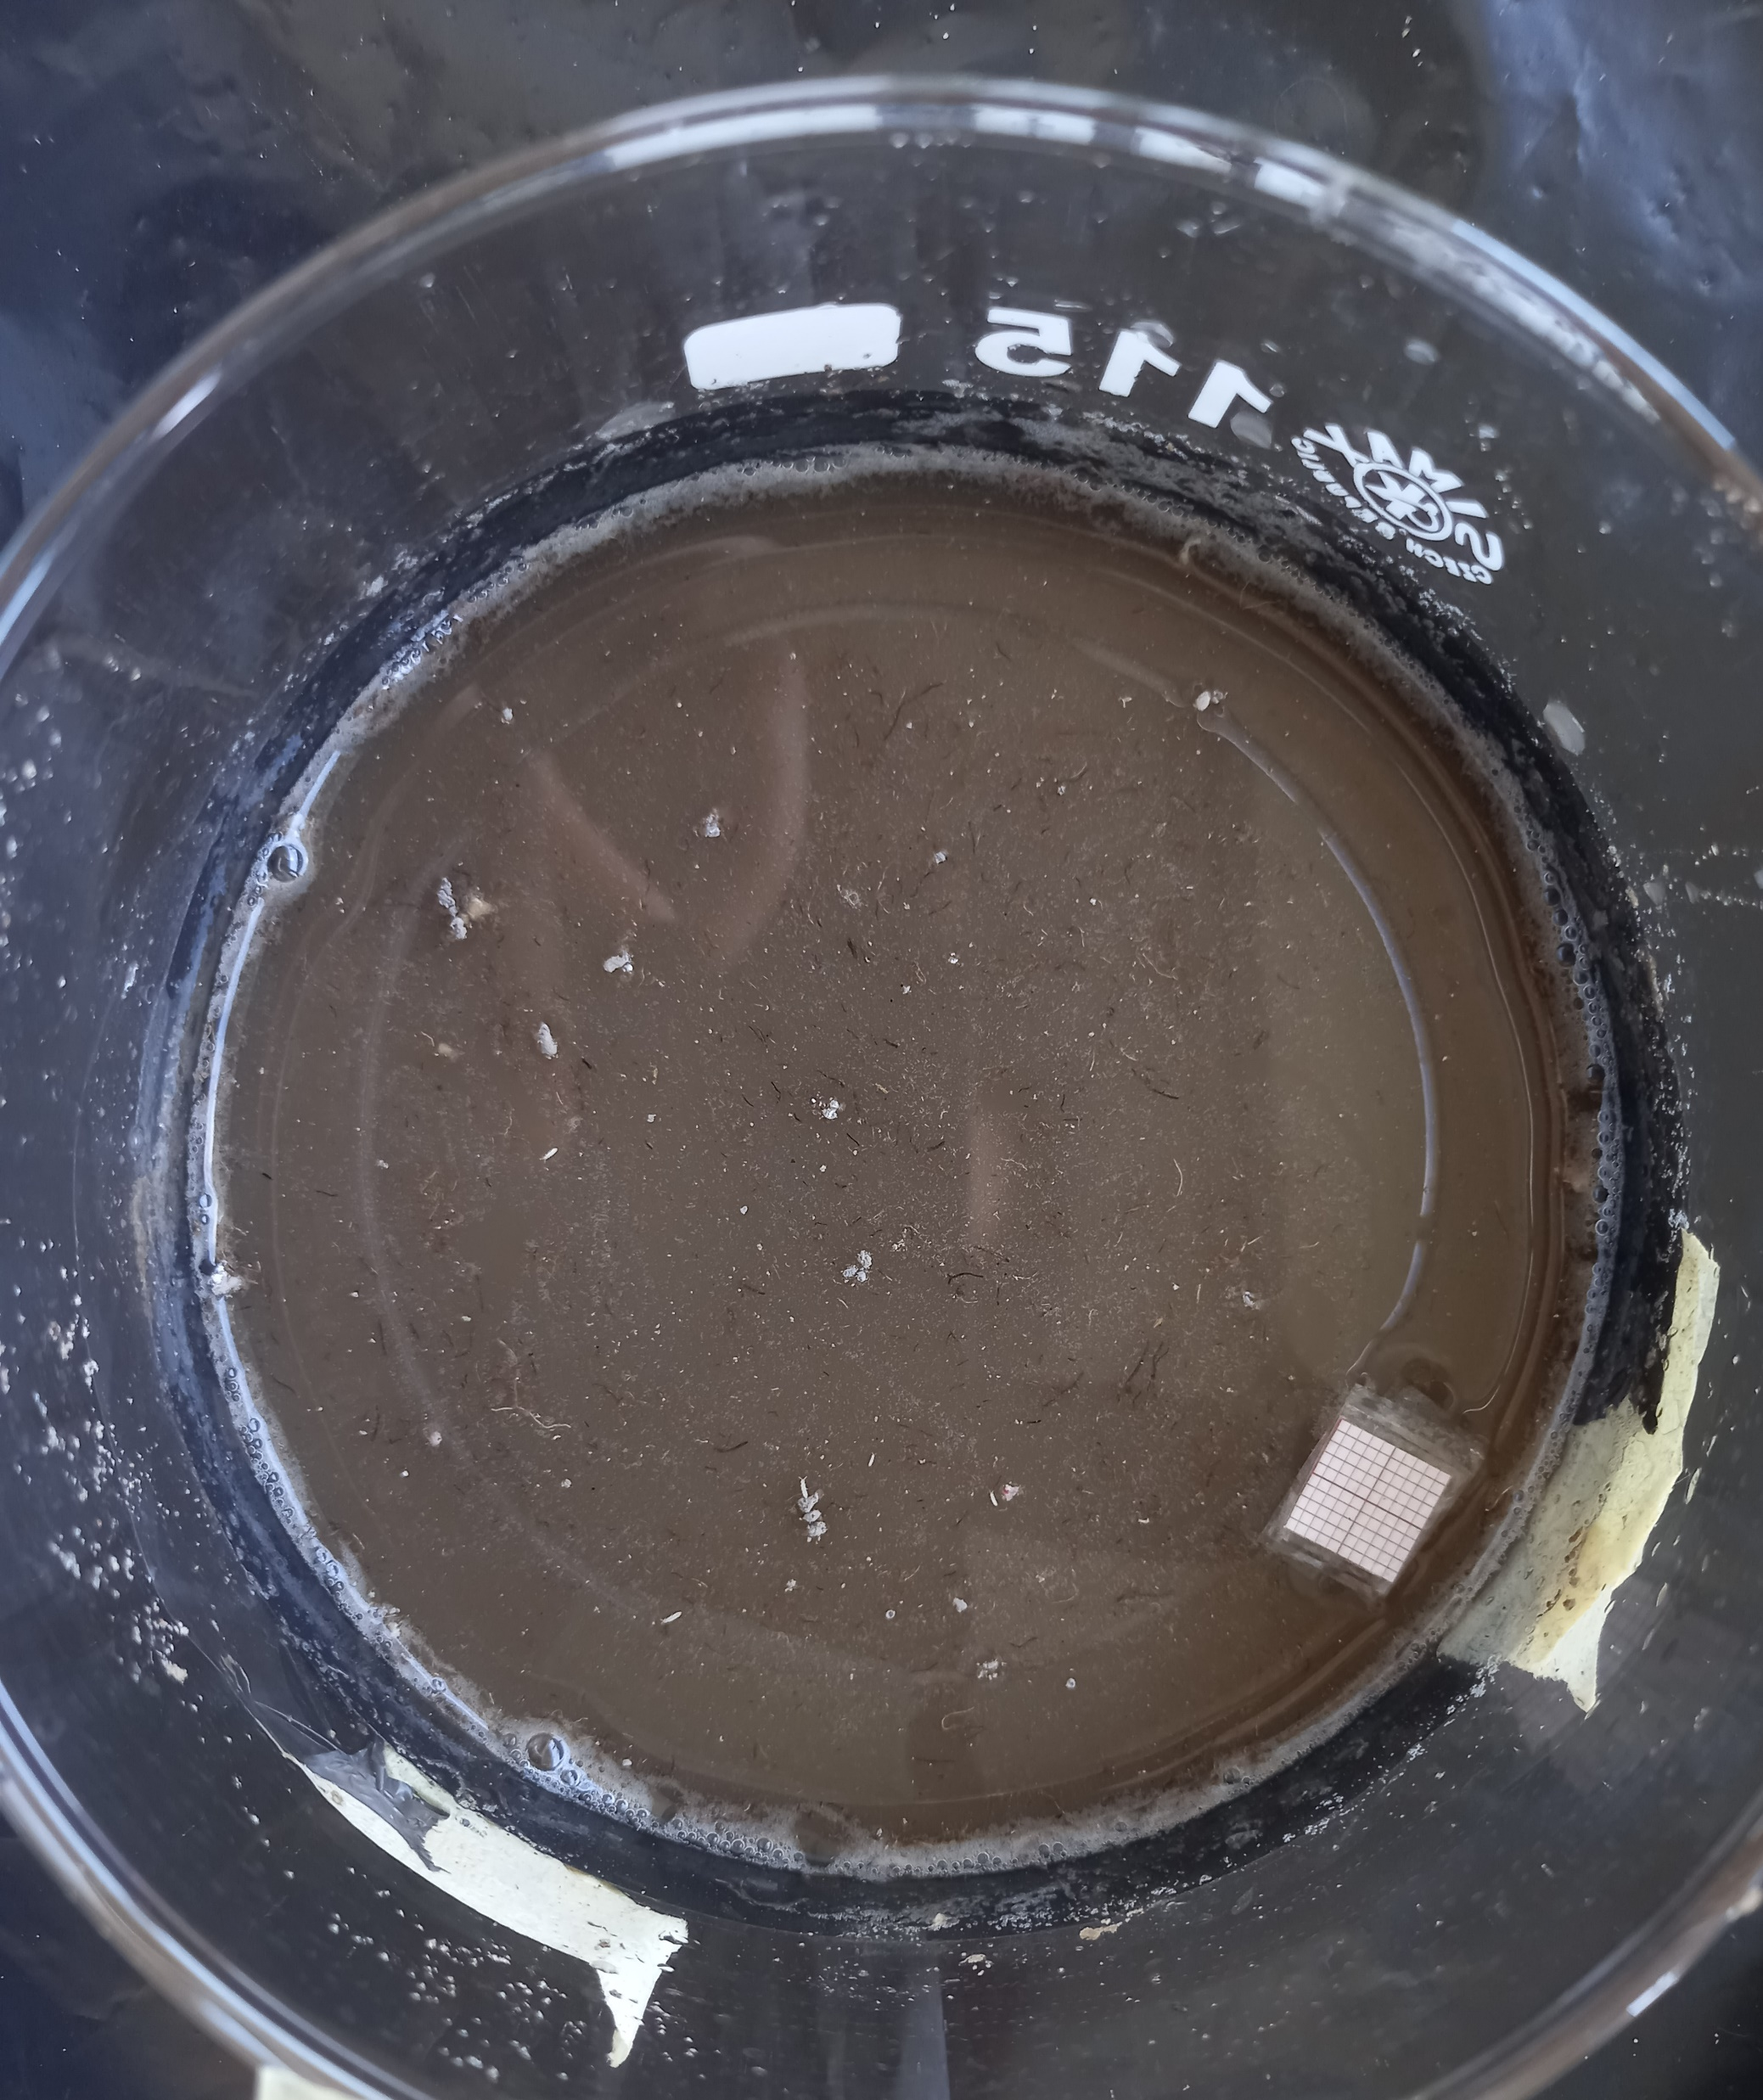
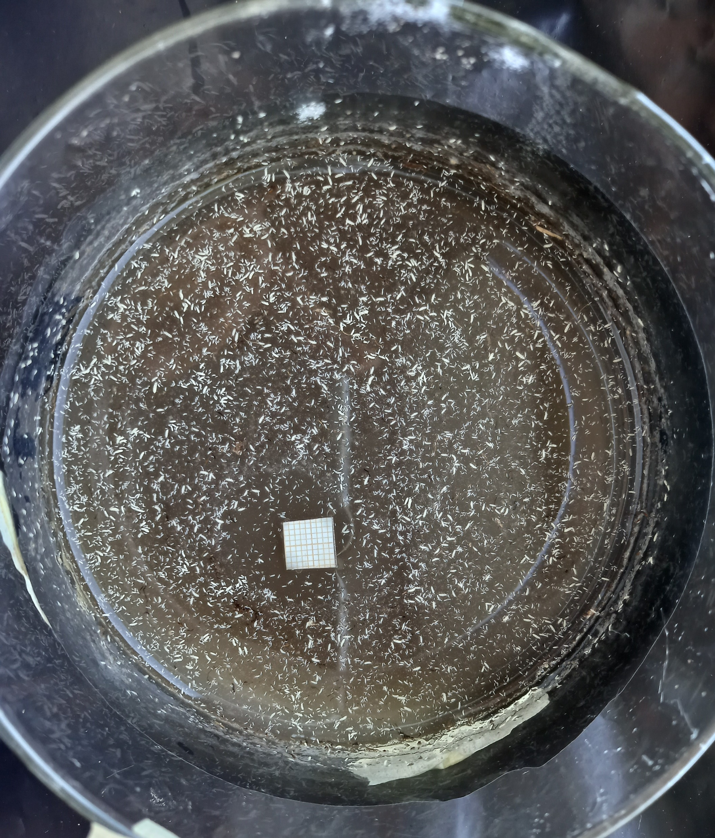
Generating annotated data
127 images with associated mask files
Images from four experiments (A, B, C, D)
Very large variation in dimensions/resolution
Very large variation in number of objects per image
D1.1 – 5 objects
A45.2 – 9,285 objects

Slide 8

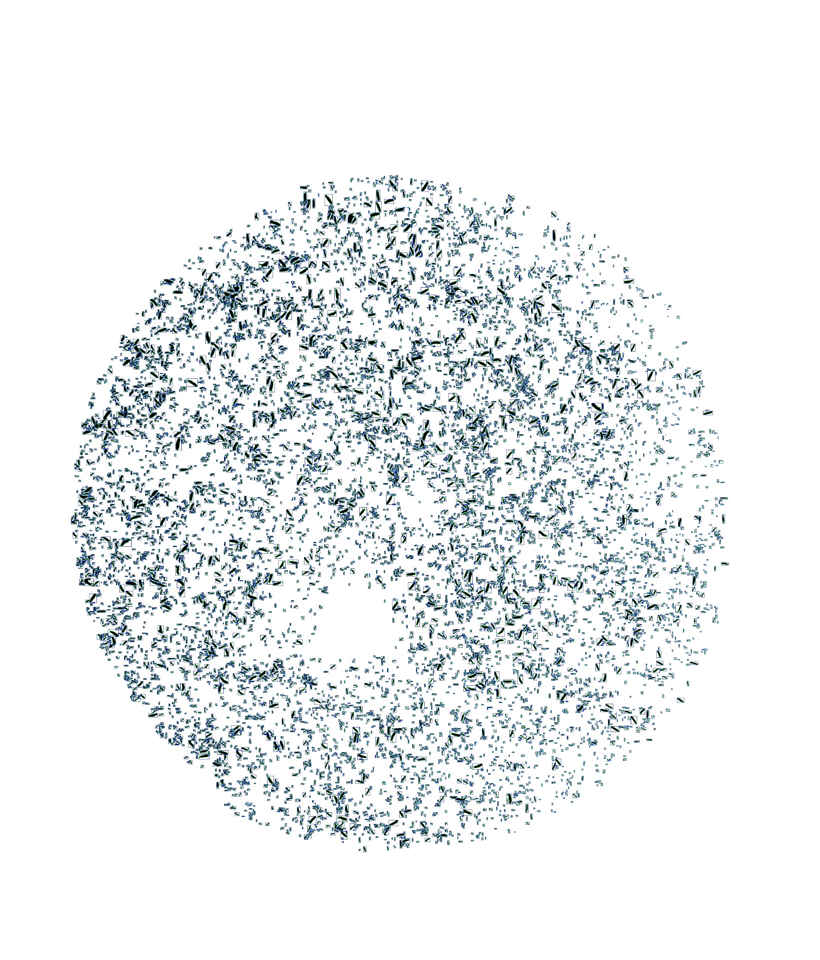
D1.1 – 5 objects
A45.2 – 9,285 objects

Slide 9
Generating annotated data
127 images with associated mask files
Images from four experiments (A, B, C, D)
Very large variation in dimensions/resolution
Very large variation in number of objects per image
Variation in number of images per experiment
A: 44
B: 39
C: 16
D: 28

Slide 10
Generating annotated data
Contour detection on binary mask
Bounding box around contour
10% box expansion

Slide 11
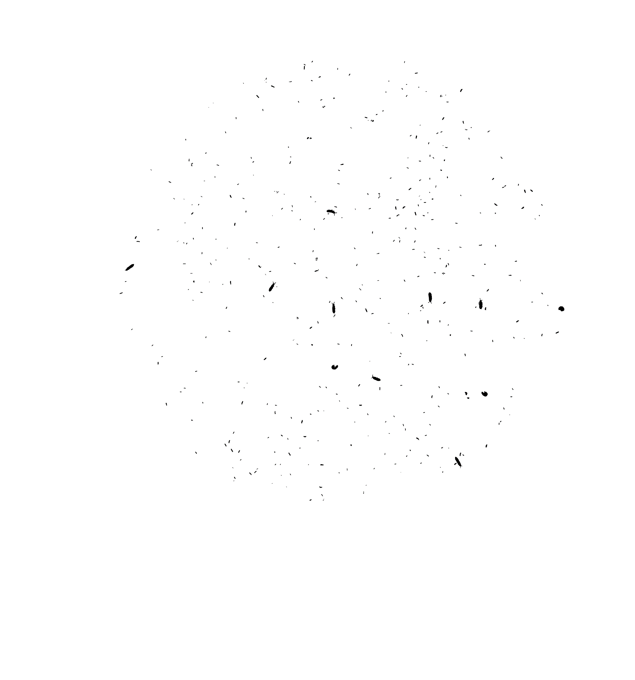

Slide 12
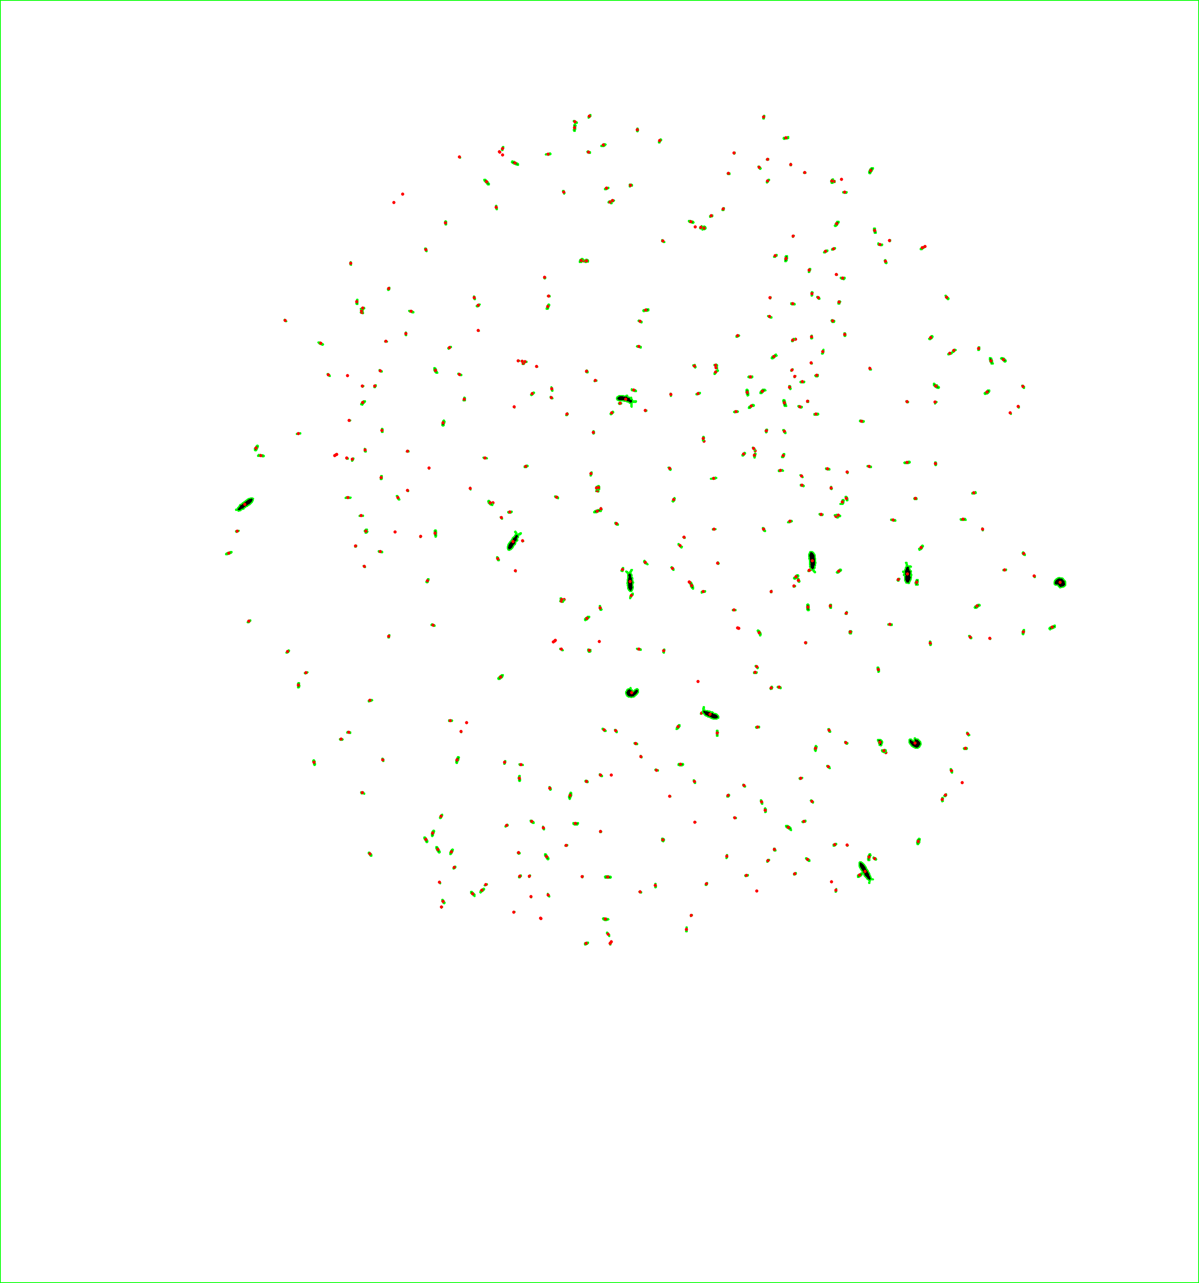

Slide 14
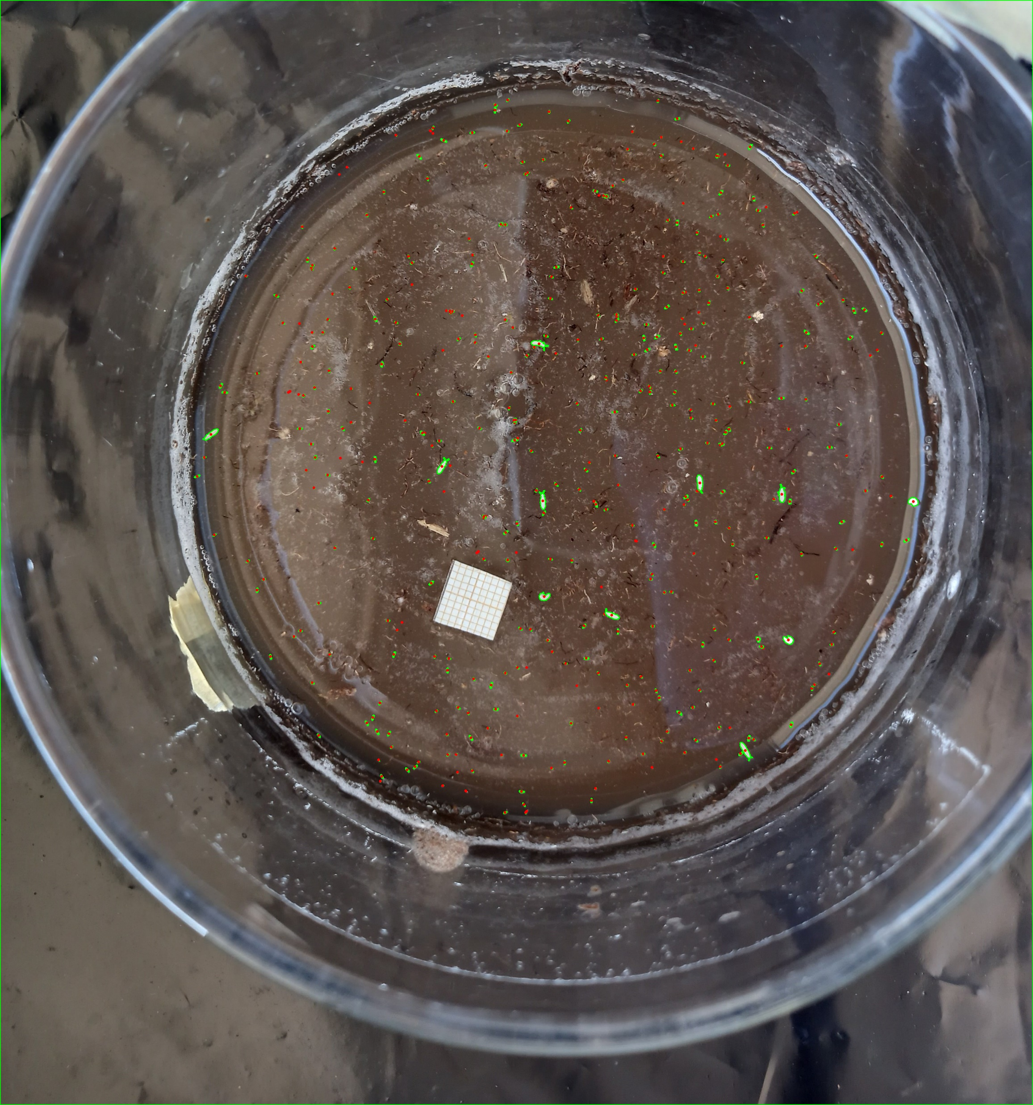

Slide 15


Automatically generated bounding boxes

Slide 16
Splitting data into training, testing, validation
We would like a 70%, 15%, 15% split between training, validation and test sets in terms of number of objects.
- we need to split at image level to ensure independency between sets
- we need to split for each experiment

Slide 17
Splitting data into training, testing, validation
Solution: Linear optimization
-Calculate perfect split at image level (e.g. 7, 3, 3 for ten images)
-Distribute images into the three groups constrained to this split, but optimize for minimum deviation from perfect split at object level
Result: Perfect split for three experiments, near perfect for one.

Slide 18
Splitting data into training, testing, validation
 | Images | Objects
Training | 89 | 77305
Validation | 19 | 17790
Testing | 19 | 15458

Slide 19
Standard model
Precision: Proportion of detections that are correct
Recall: Proportion of objects that were detected
F1: Harmonic mean of precision and recall
Precision = 0.89
Recall = 0.09
Confidence threshold = 0.1
IOU threshold = 0.2
Annotations: 15458
Detections: 1522
Correct detections: 1348
False positives: 174
False negatives: 13992

Slide 20
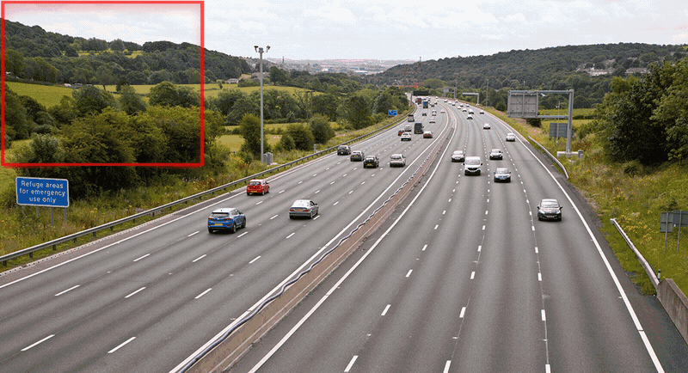
Slicing model
Slice training data into 640 x 640
Train model
Predict with sliding window (640 x 640) (SAHI)

Slide 21
Slicing model
Slice training data into 640x640 crops

Slide 22
Slicing model
Slice training data into 640x640 crops

Slide 23
Slicing model
Slice training data into 640x640 crops

Slide 24
Slicing model
 | Images | Objects
Training | 4166 | 93557
Validation | 849 | 21795
Testing | 846 | 19127

Slide 25
Slicing model
Precision: Proportion of detections that are correct
Recall: Proportion of objects that were detected
F1: Harmonic mean of precision and recall
Precision = 0.84
Recall = 0.90
Confidence threshold = 0.1
IOU threshold = 0.2
Annotations: 15458
Detections: 16513
Correct detections: 13923
False positives: 2590
False negatives: 1487

Slide 26
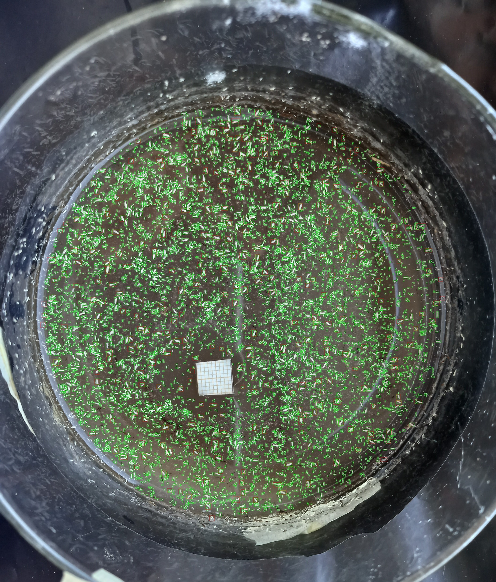
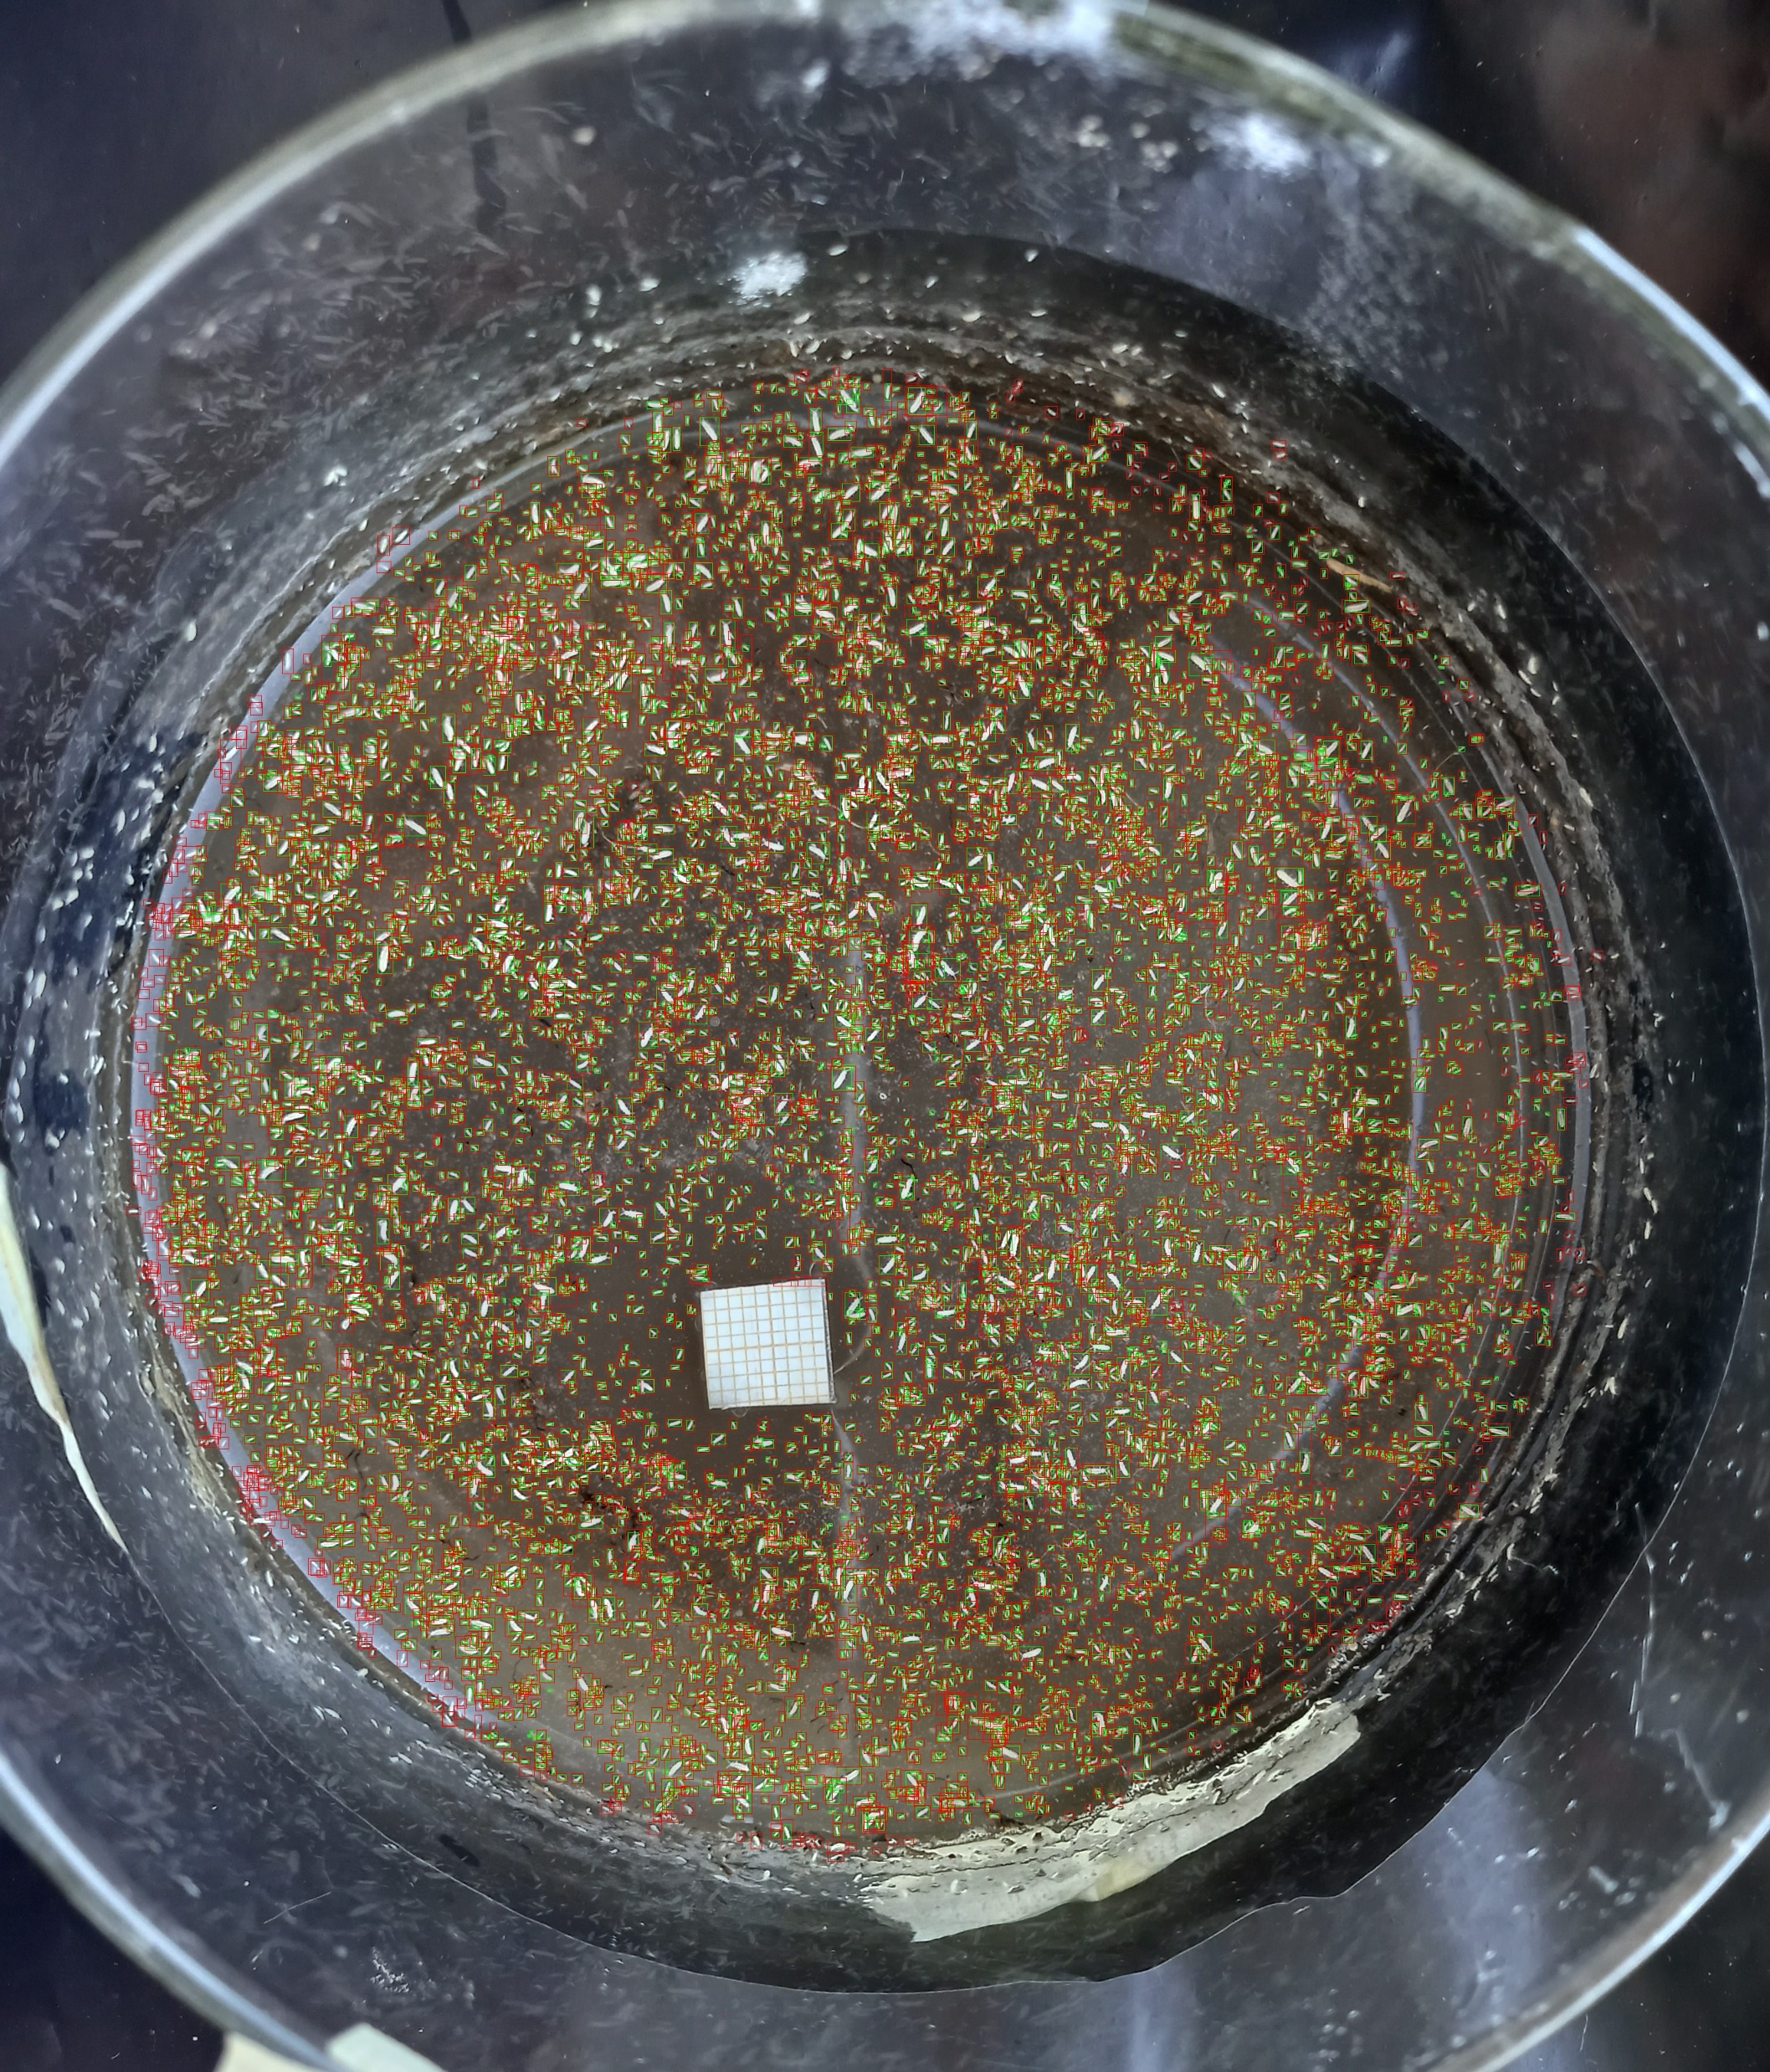
Results
Annotation
Standard
Slicing
Prediction
P: 0.97
R: 0.03
P: 0.94
R: 0.92

Slide 27
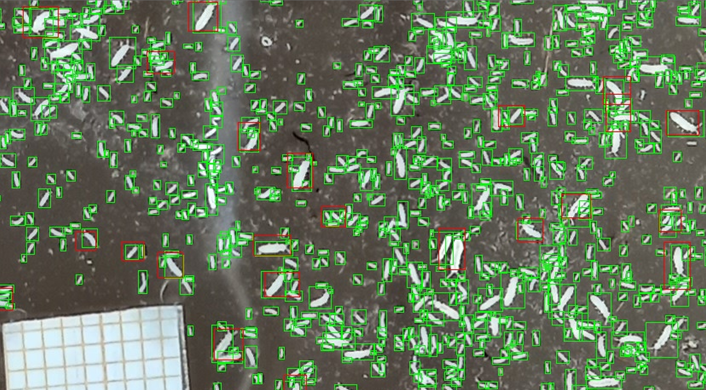
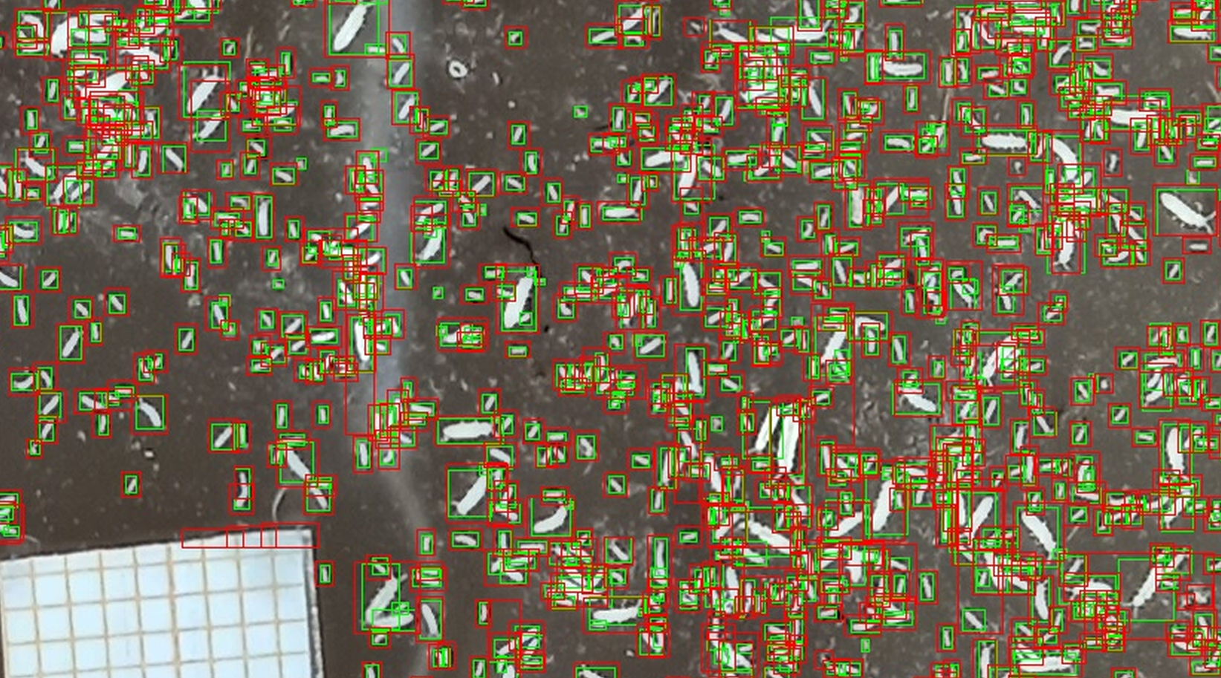
Results
Annotation
Standard
Slicing
Prediction
P: 0.97
R: 0.03
P: 0.94
R: 0.92

Slide 28
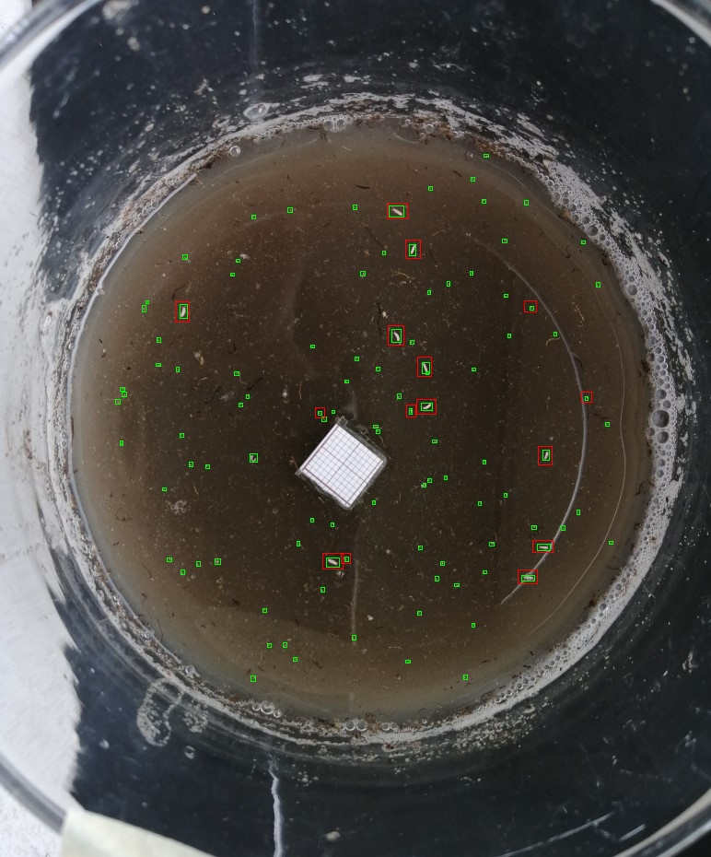
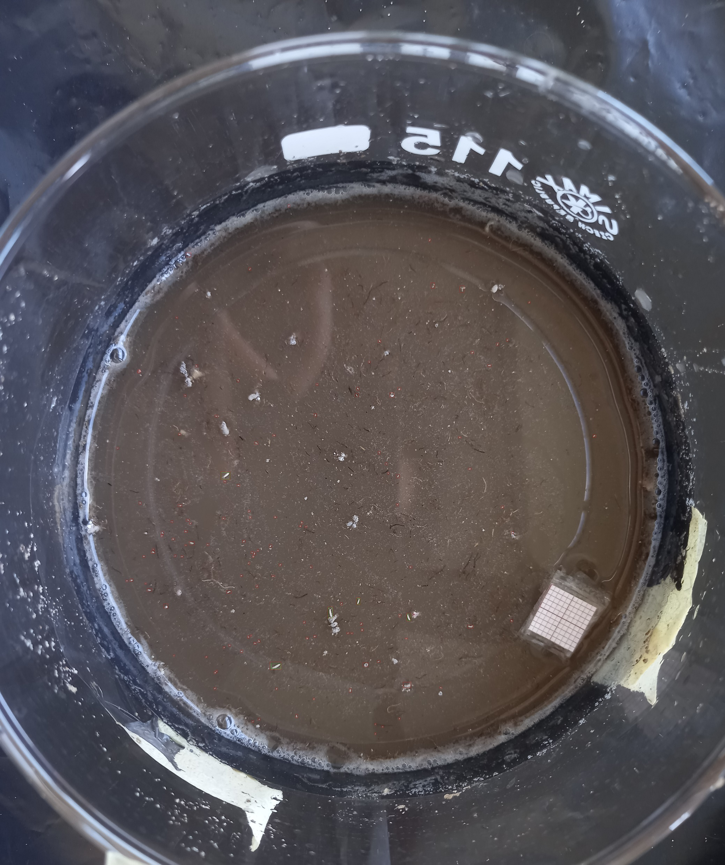
P: 0.93
R: 0.14
P: 0.04
R: 1.0

Slide 29
Worst recall
Worst precision
P: 0.93
R: 0.14
P: 0.04
R: 1.0

Slide 30
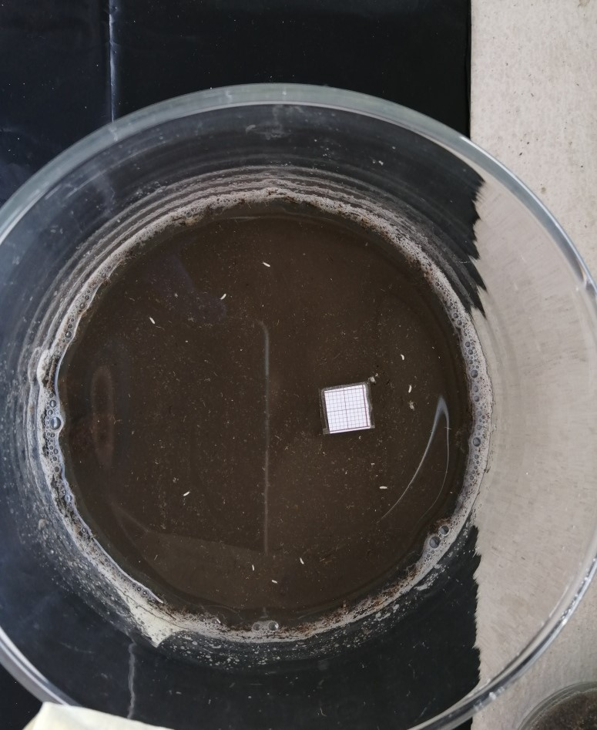
Petri pixels
Is model accuracy associated with resolution of petri dish?

Slide 31
Petri pixels

Slide 32
Petri pixels
255,145 pixels

Slide 33
Petri pixels
255,145 pixels
Lowest: 70,000
Highest: 22,312,165

Slide 34
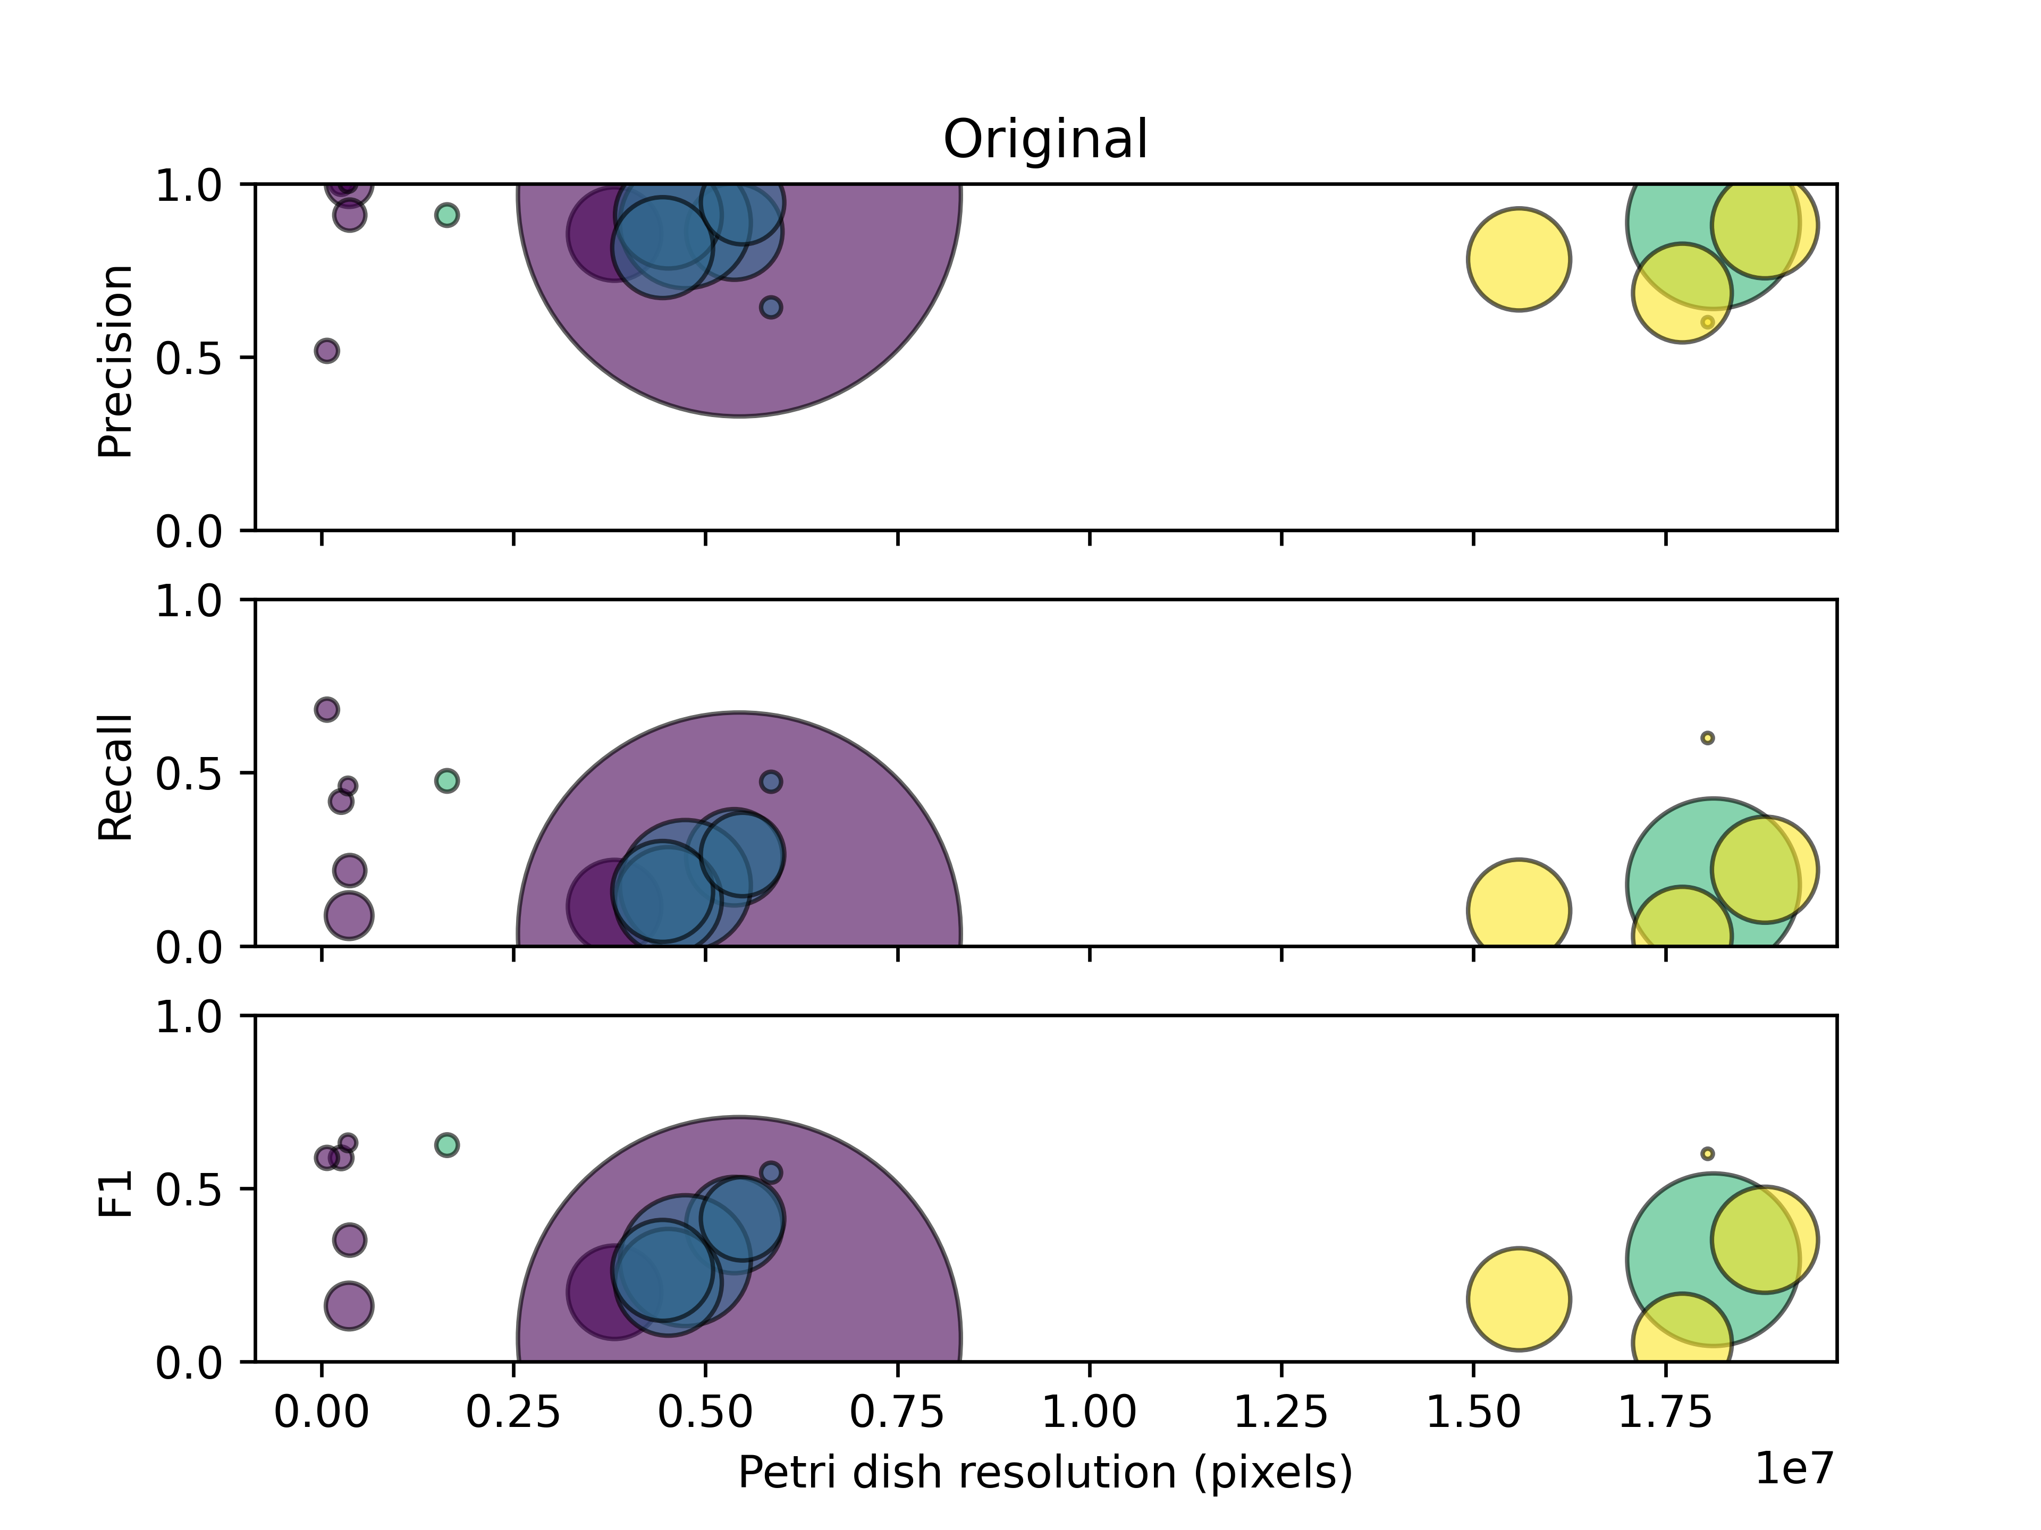
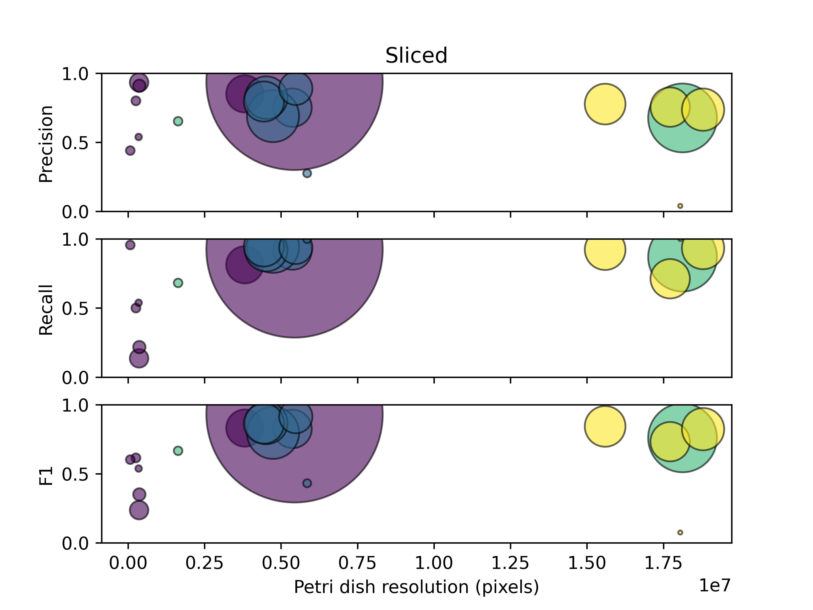
Petri pixels

Slide 35

Pixels per object
Is accuracy associated with the number of pixels per object?

Slide 36
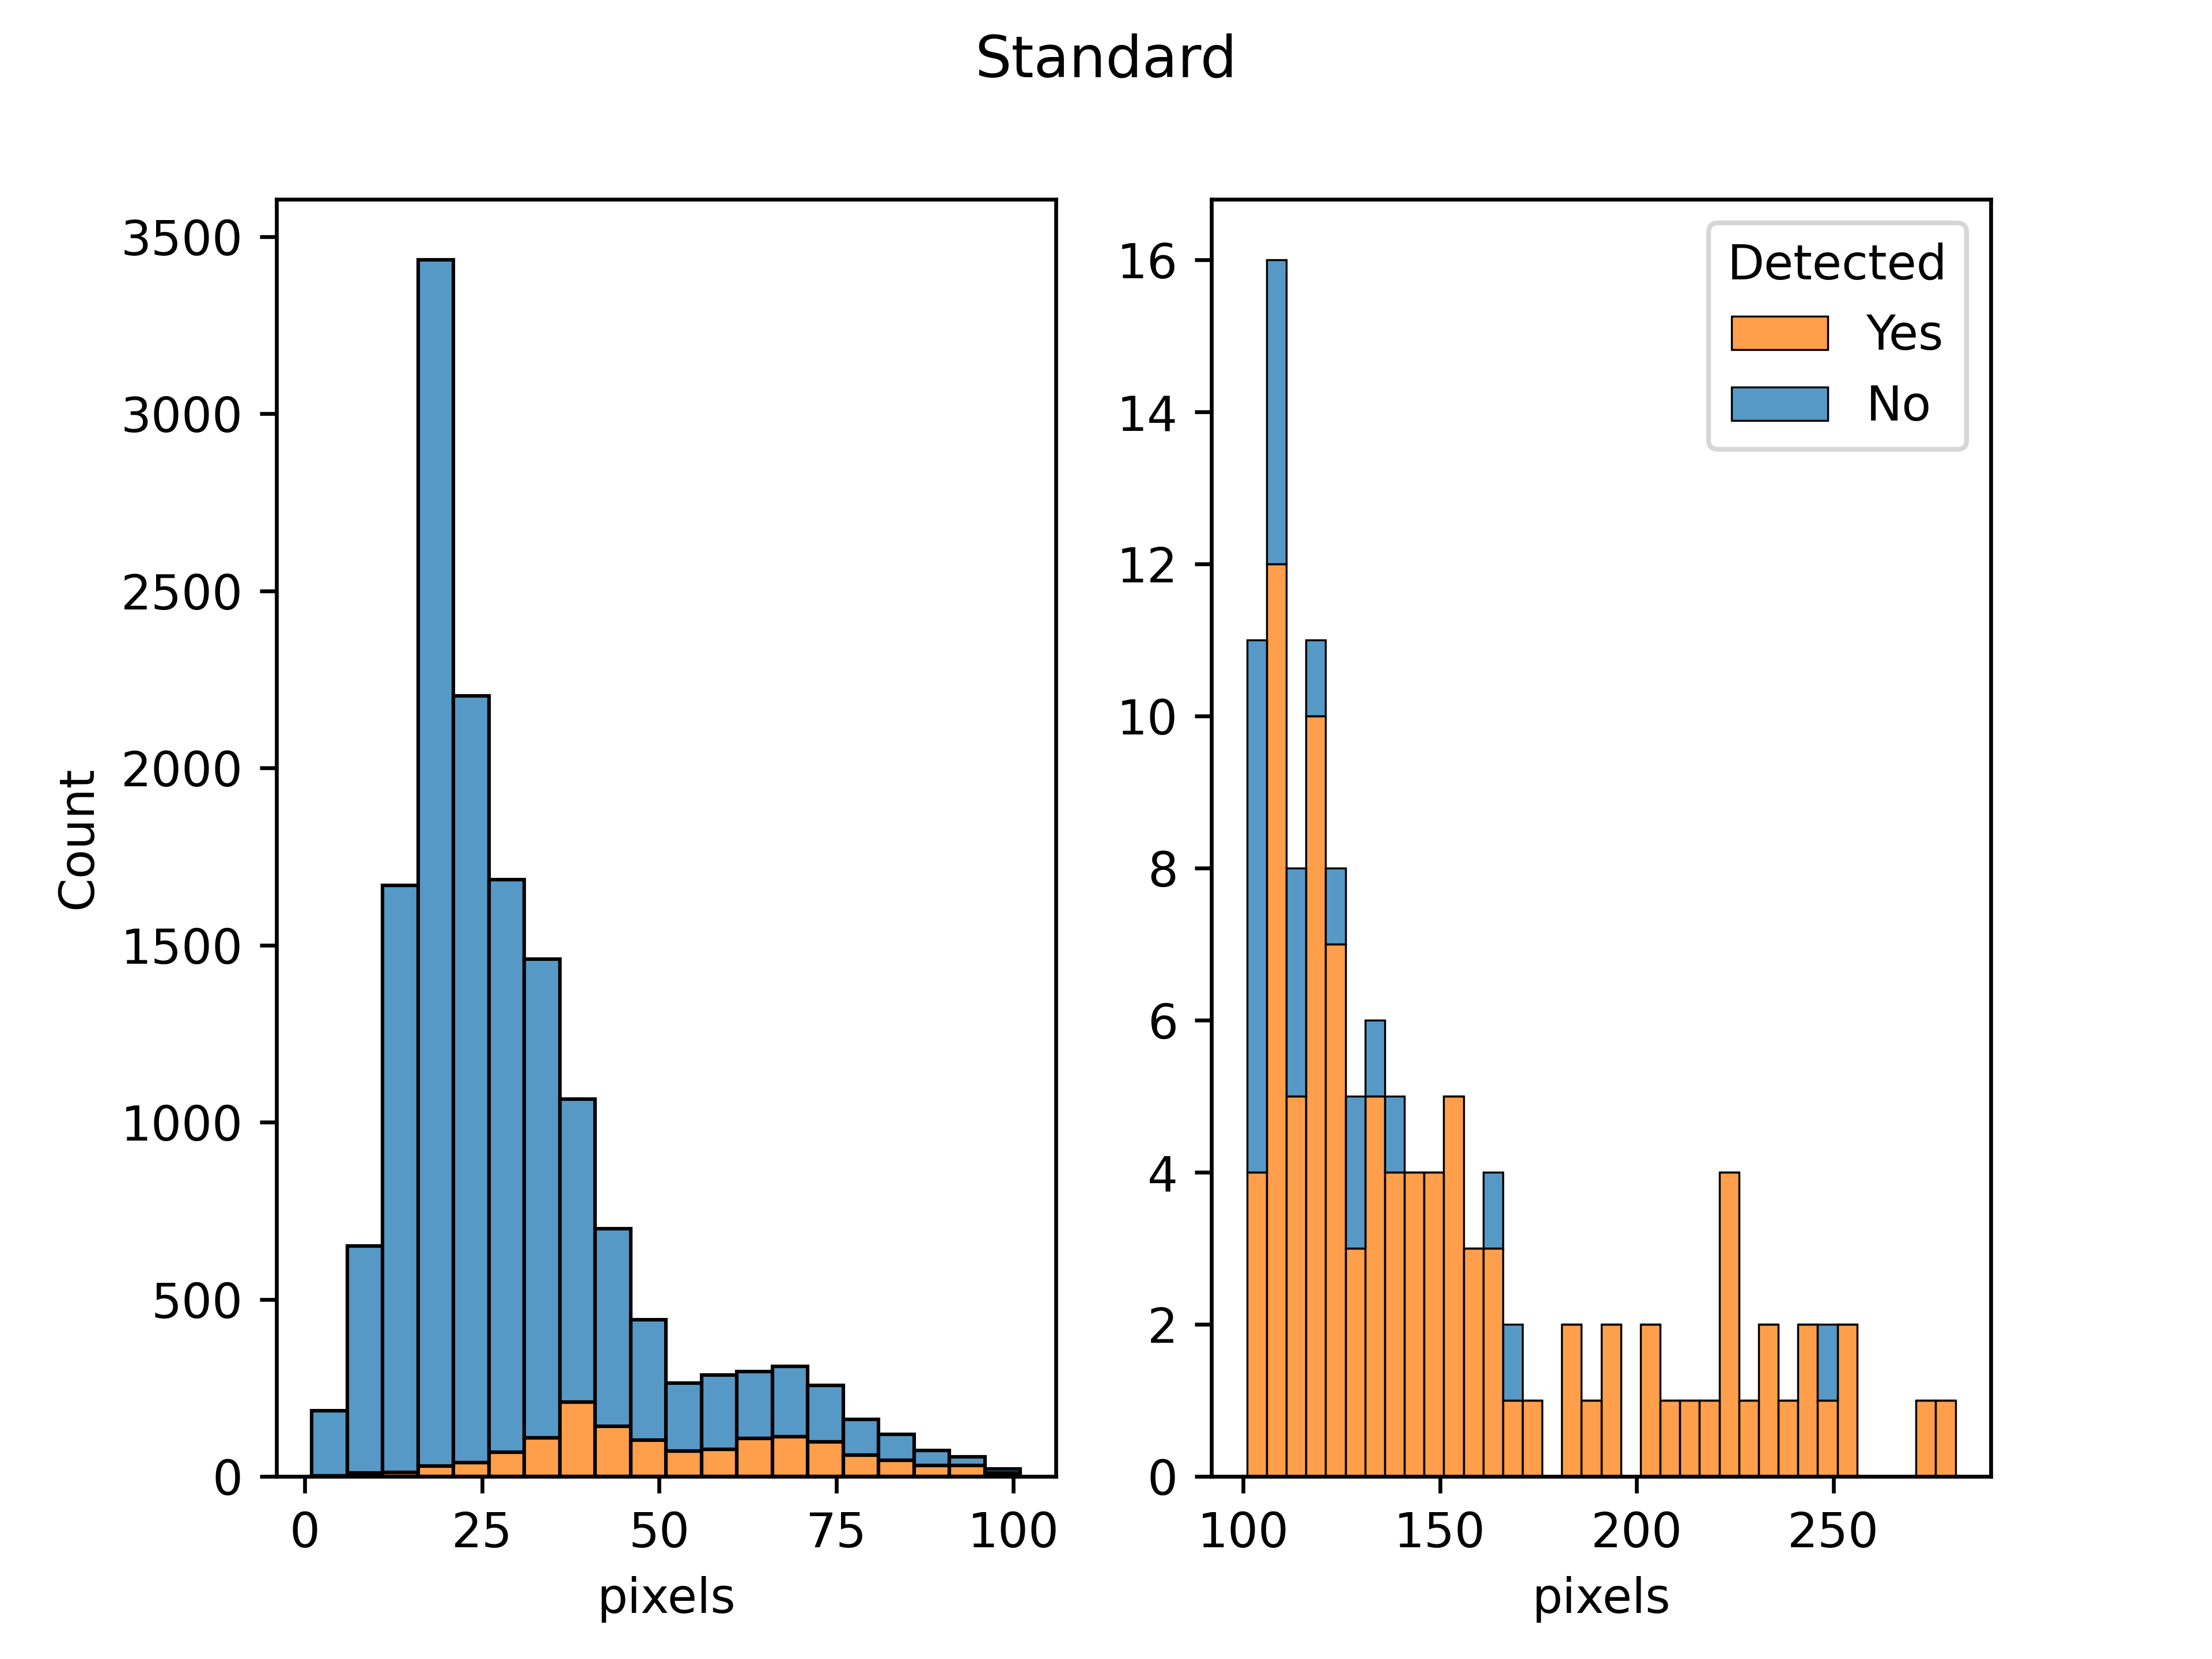
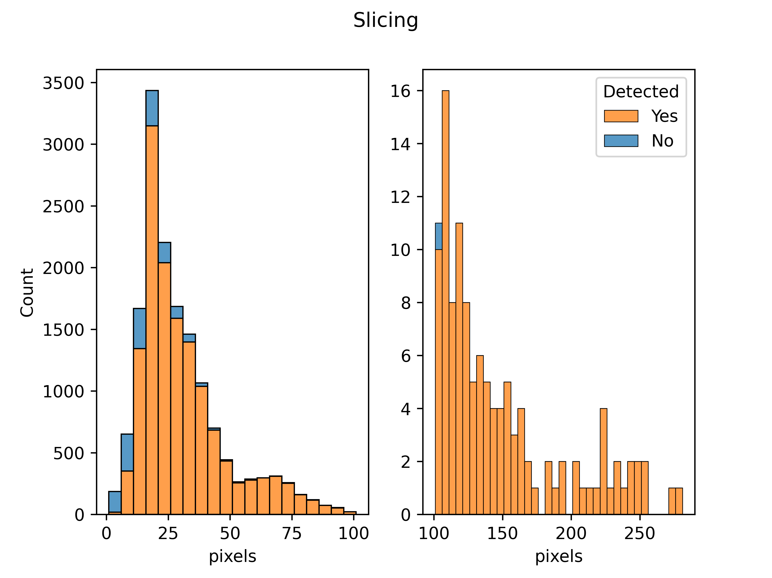
Pixels per object
Small objects are probably less likely to be a correct annotation

Slide 37
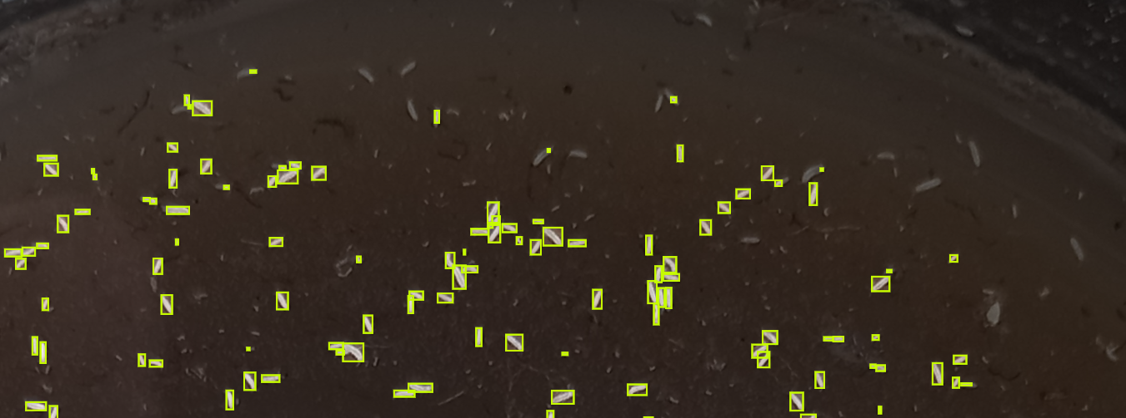
Human error

Slide 38
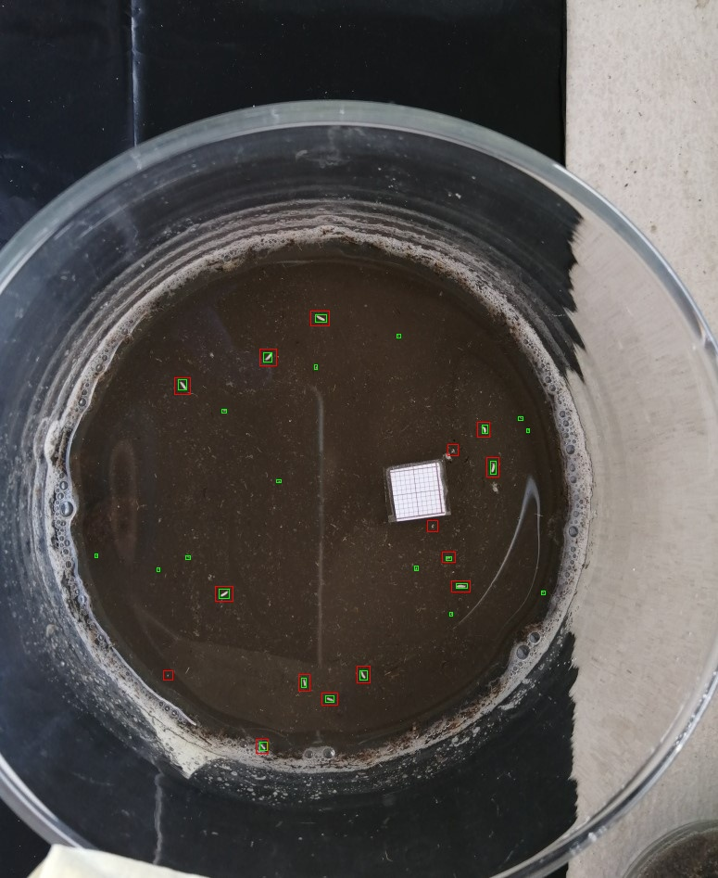

Human error

Slide 39

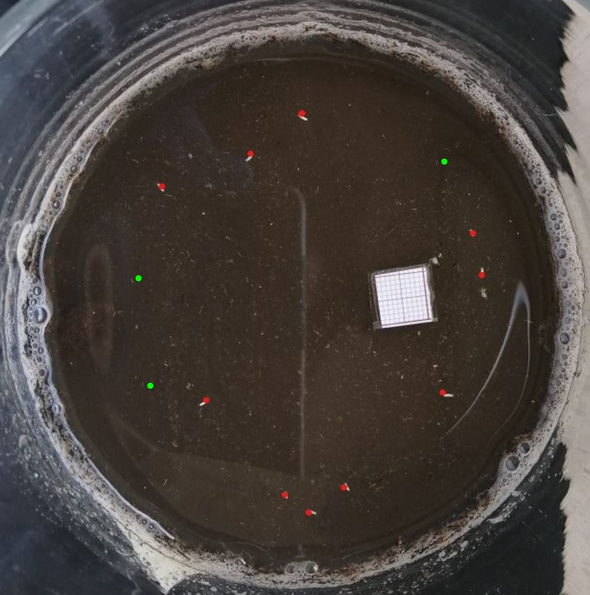
Human error

